Slide 1
SUMMER INTERNSHIP
VENKATA NAGA SAI KALYANI CHERUKURI
AP22110010186
MENTOR:Dr manjula
EMPLOYEE BURNOUT PREDICTION

Slide 2
INTRODUCTION
EMPLOYEE BURNOUT PREDICTION:
Employee burnout prediction involves identifying early signs of chronic workplace stress through data analysis and machine learning.
By monitoring factors like workload, hours worked, and employee feedback, organizations can proactively address burnout, enhancing employee well-being, productivity, and retention.
This approach fosters a healthier, more sustainable work environment.

Slide 3
WHAT IS EMPLOYEE BURNOUT PREDICTION?
Employee burnout is a state of physical, emotional and mental exhaustion caused by excessive and prolonged stress. It can have serious consequences on an individual's well-being and can lead to decreased productivity and job performance. In today's fast-paced and constantly connected world, it is increasingly important to recognize and address the signs of burnout in order to maintain the health and well-being of employees.

Slide 4
Factors causing Employee Burnout Prediction
High Workload: Excessive work demands and long hours can lead to chronic stress.
Lack of Control: Limited autonomy and decision-making power can create feelings of helplessness.
Inadequate Rewards: Insufficient recognition, compensation, and benefits can reduce motivation.
Poor Work-life Balance: Difficulty in balancing professional and personal responsibilities leads to stress.
Unclear Job Expectations: Ambiguity in roles and responsibilities can cause confusion and frustration
.Poor Management: Lack of support, feedback, and communication from supervisors can contribute to burnout.
Toxic Work Environment: Negative workplace culture, conflicts, and lack of teamwork can affect mental health.
Insufficient Social Support: Lack of support from colleagues and management can lead to feelings of isolation.
Personal Factors: Individual characteristics like resilience, coping mechanisms, and external stressors also impact burnout.

Slide 5
Uses:
Early Intervention: Identifying signs of burnout early allows for timely interventions, reducing the risk of severe burnout.
Enhanced Employee Well-being: Proactively addressing burnout helps improve overall employee health and well-being.
Improved Productivity: Preventing burnout leads to higher engagement, efficiency, and productivity.
Reduced Turnover: By addressing burnout, organizations can decrease employee turnover and retain talent.
Better Workforce Planning: Insights from burnout prediction help in workload distribution and resource allocation.
Enhanced Employee Satisfaction: Proactive measures to prevent burnout contribute to higher job satisfaction and morale.

Slide 6
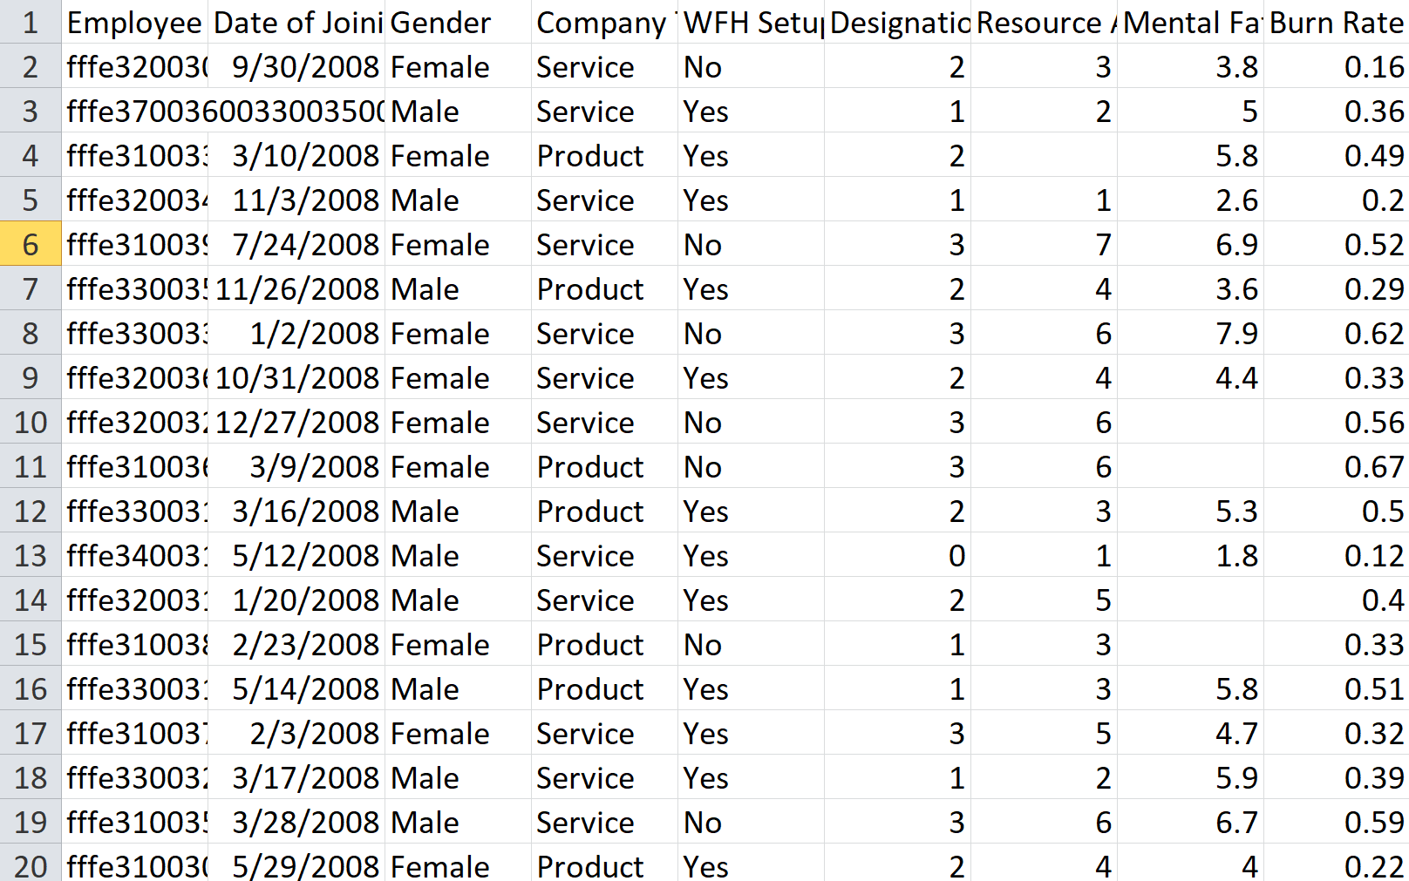
DATA SET:

Slide 7
This dataset consists of 9 columns as follows:
Employee ID: The unique ID allocated for each employee (example: fffe390032003000)
Date of Joining: The date-time when the employee has joined the organization (example: 2008-12-30)
Gender: The gender of the employee (Male/Female)
Company Type: The type of company where the employee is working (Service/Product)
WFH Setup Available: Is the work from home facility available for the employee (Yes/No)
Designation: The designation of the employee of work in the organization. In the range of [0.0, 5.0] bigger is higher designation.
Resource Allocation: The amount of resource allocated to the employee to work, ie. number of working hours. In the range of [1.0, 10.0] (higher means more resource)
Mental Fatigue Score: The level of fatigue mentally the employee is facing. In the range of [0.0, 10.0] where 0.0 means no fatigue and 10.0 means completely fatigue.
Burn Rate: The value we need to predict for each employee telling the rate of Bur out while working. In the range of [0.0, 1.0] where the higher the value is more is the burn out.

Slide 8
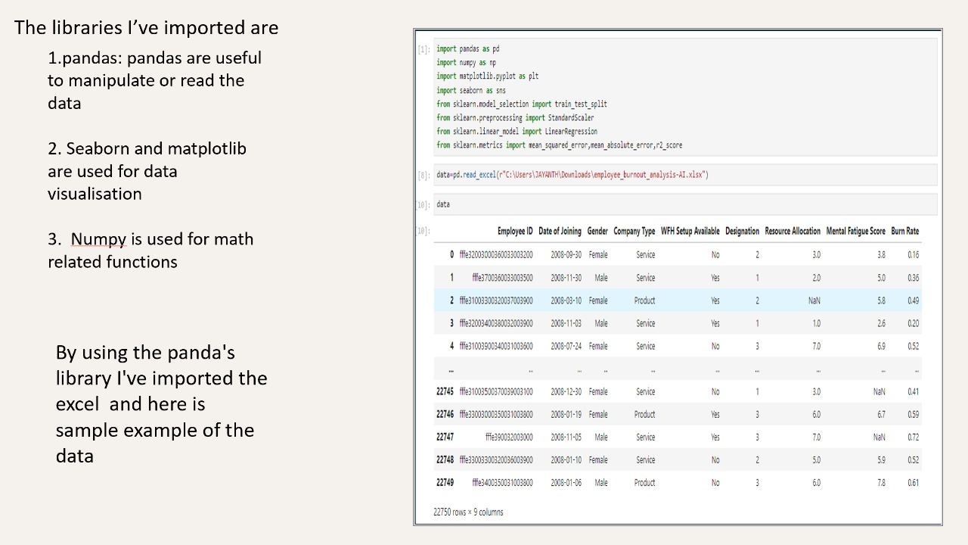

Slide 9
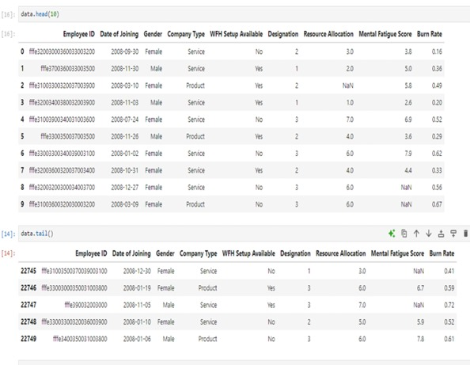

Slide 10
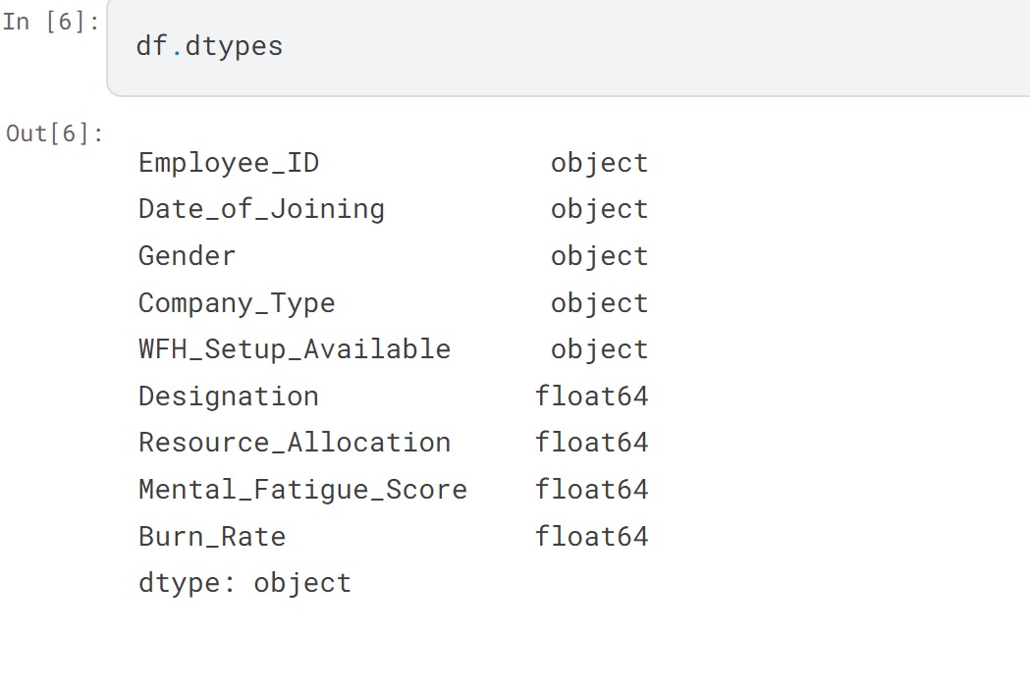

Slide 11
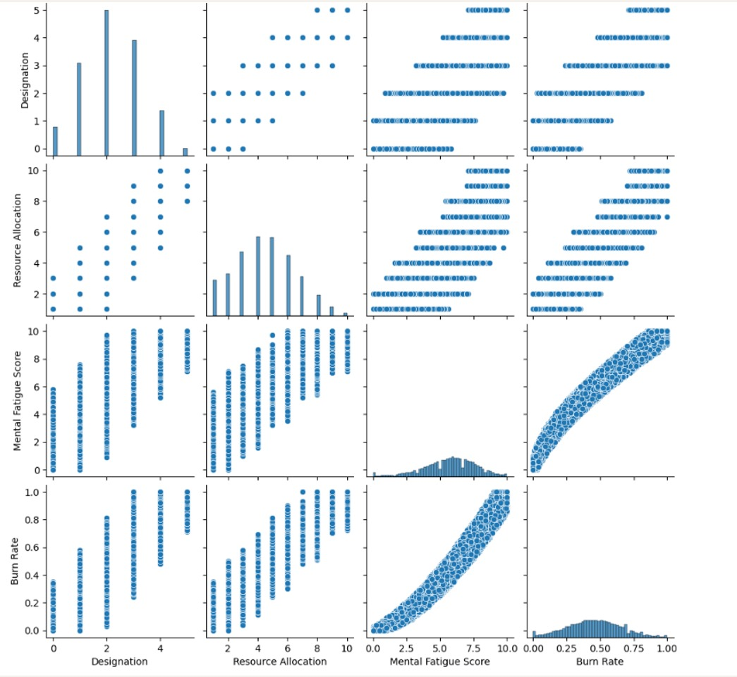
DATA VISUALISATION

Slide 12
CONCLUSION
Employee burnout prediction is a vital tool for modern organizations, enabling them to proactively identify and address potential burnout issues. By leveraging data analytics and machine learning, companies can create healthier work environments, enhance employee well-being, and improve overall productivity. Implementing effective burnout prediction strategies not only reduces turnover and associated costs but also fosters a more engaged and satisfied workforce, ultimately contributing to the long-term success of the organization.

